Slide 1
Introduction to Wireless Sensor Networks
Kari Jyrkkä

Slide 2
Description of Curriculum
Learning outcomes
The student knows the basic wireless sensor and transmission technology and network management used in wireless sensor networks. He or she is familiar with current applications and understands the limitations of wirless sensor networks.
Contents
Introduction to sensor and transmission technology and network management. Basics of power management. Evaluation of typical wirless sensor network applications.

Slide 3
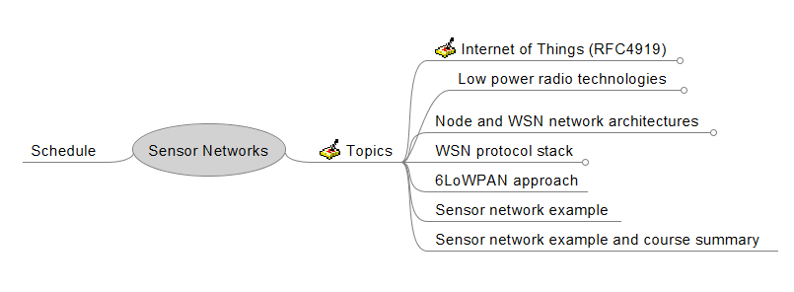

Slide 4
Assessment
Excercises during lectures 3p / each monday
Home work 3p / each week
Possible group work at the end of the course
No final exam

Slide 5
Materials
www/optima.oamk.fi
Books
  6LoWPAN The Wireless Embedded Internet
  Essentials of Short-Range Wireless
  Low-Power Wireless Sensor Networks
  Building Wireless Sensor Networks
  Zigbee Wireless Networks and Tranceivers

Slide 6
Introduction
Form 5 persons groups.
Discuss on
  What sensor networks are?
  What kind of experience the group has on sensor networks?
  How sensor networks are different from other wireless networks?
Be prepared to present your group results

Slide 7
Excercise 1
Listen to the given video and try to find answers to following questions:
6LoWPAN seminar
What does Core, Fringe and Ingernet of Things mean?
In what state Internet of Things is now?
How utilization of standards is justified?

Slide 8
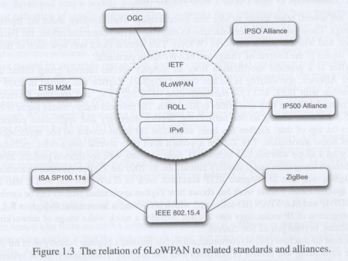
Excercise 2
What is the special interest of each organization?
What kind of applications the organizations are promoting
What kind of technology the organizations are promoting?
ETSI_M2M
OGC
IPSO Alliance
IP500 Alliance
Zigbee alliance
IEEE 802.15.4
ISA SP100.11a,ISA
IETF 6LoWPAN
IETF ROLL

Slide 9
Interest
Applications
Tecnology
ETSI
Internet of things standards
Coordination. Horizontal
approach
All possible applications
Reusing existing techology
Core networks, Access networks
M2M area networks
All possible applications
OGC
IPSO
Zigbee
802.15.4

Slide 10
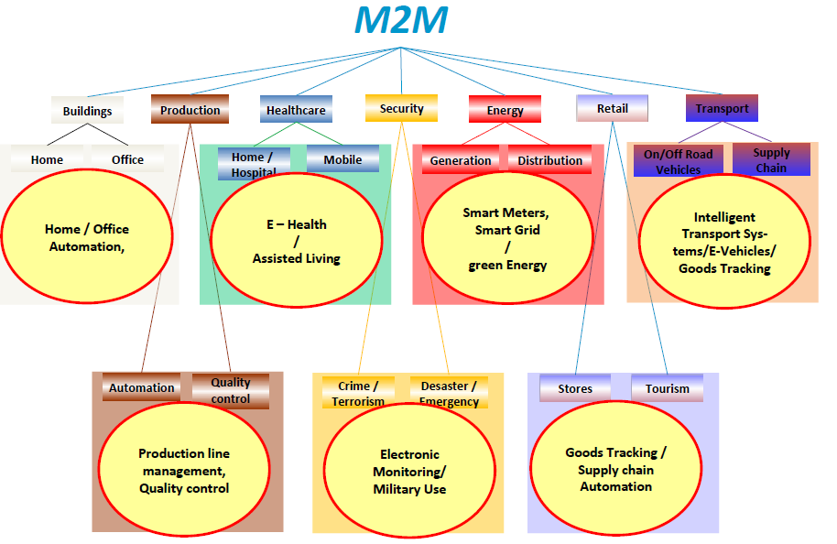
Exercise 3
Find real wireless sensor network applications from Web. Try to find 1-3 applications from some of categories given above.
And be prepared to present your findings

Slide 11
Excercise 4 (group of 3-5 persons)
Let’s define our own application, which uses sensor networks somehow.
If possible try to keep your ideas in such level that we could actually implement your idea during the course.
Define following requirements for your idea
  Bit rate
  How many nodes are needed
  Maximum range of wireless connection
  Max cost of the system in order to be attractive
  Etc.
Be prepared to present your results to the group

Slide 12
Group excercise (2-3 persons) (1-3p)
What seems to be the current state of wireless sensor networks?
Name 2 standards bodies that seems to be the most important for Wireless Sensor Networks to become reality.
What standards there are for sensor networks?
What is the difference between IEEE802.15.4 and Zigbee?

Slide 13
What seems to be the current state of wireless sensor networks?
  1980s wired sensors => at the end of 1990 proprietary wireless sensor networks => Mid 2000 802.15.4 standard + Zigbee standard => Now IPv6 based solution= 6LoWPAN being standardized at IETF.
  Some sensor network applidations are already available.
  ”Killer application” is still missing.
Name 2 standards bodies that seems to be the most important for Wireless Sensor Networks to become reality.
  IEEE 802.15.4 = Low Pover radio specification
  IETF/6LoWPAN = IPV6 based communication until sensor network node.
  Zigbee alliance is also going towards IPv6
  ISA has adopted 6LoWPAN as their networks solution.
What standards there are for sensor networks?
  IEEE 802.15.4
  Zigbee
  RFC4919, RFC4944, RFC6282, RFC6775 (IETF/6LoWPAN standards)
What is the difference between IEEE802.15.4 and Zigbee?
  IEEE802.15.4 is low power radio specification (PHY + MAC)
  Zigbee defines network layer and application profiles on top of low power radio.

Slide 14
Extra homework
What is/was Bruce Sterling’s contribution to Internet of Things?????

